Slide 1
flockListGenerator
(former) Elder Andrew Jones

Slide 2
Why Make a Flock List?
List of all member families you are working with
The Ward Mission Leader cannot see your area book timelines for members, so a flock list allows them to see when you visit families in the ward and what commitments you are giving them
A other way to be accountable to ward council
Quick visualization of which members need to be followed up with soon
The flockListGenerator script saves you the tedious work of filling in all the households manually, and allows you to skip straight to the effective usage of the flock list with your ward mission leader.
“Choose to be proactive in accounting for your work to the Lord and to your mission leaders. Don’t wait to be asked.”
-- Preach My Gospel, chapter 8

Slide 3
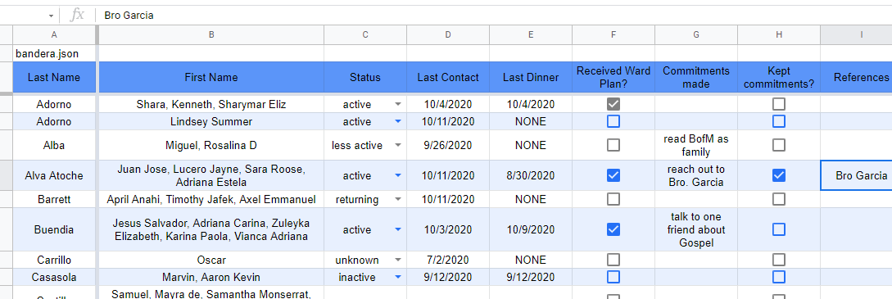
What it looks like

Slide 4
A word of caution
An out-of-date spreadsheet is the least useful type of spreadsheet. If you do not plan on using this sheet regularly, it will probably not be useful!
Discuss with your ward mission leader whether this would be a helpful tool in addition to the nightly texts and/or weekly emails, which are the standard coordination tools.

Slide 5
How to set up & use the flock list generator

Slide 6
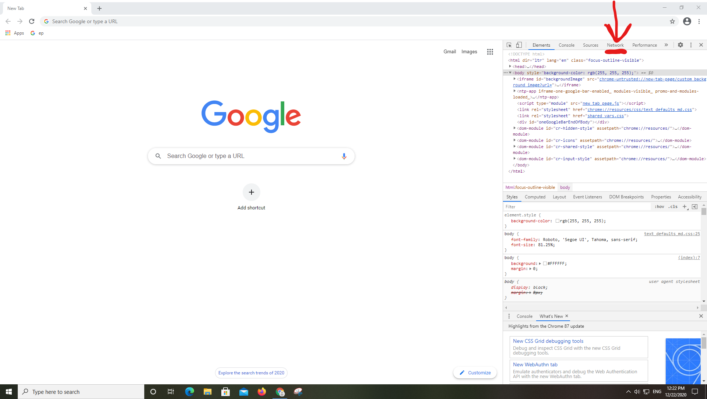
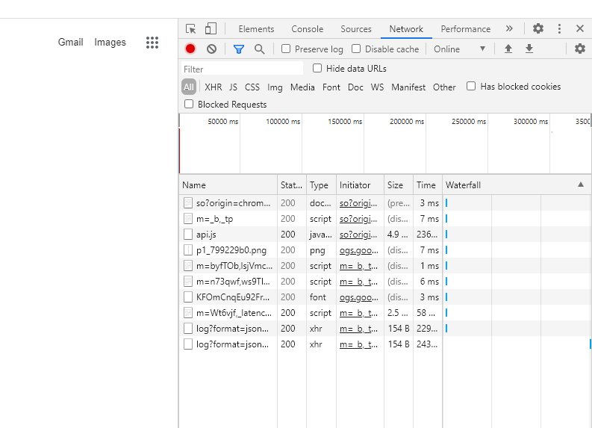
Step 1: inspect element
We are going to use some coding tools to get our hands on a data file.
Open google chrome
Press F12. The sidebar with all the code will open up.
Click the “Network" tab at the top of the window. It will look like this →
On the same tab, visit the website: areabook.churchofjesuschrist.org (ignore the F12 box for a moment)

Slide 7
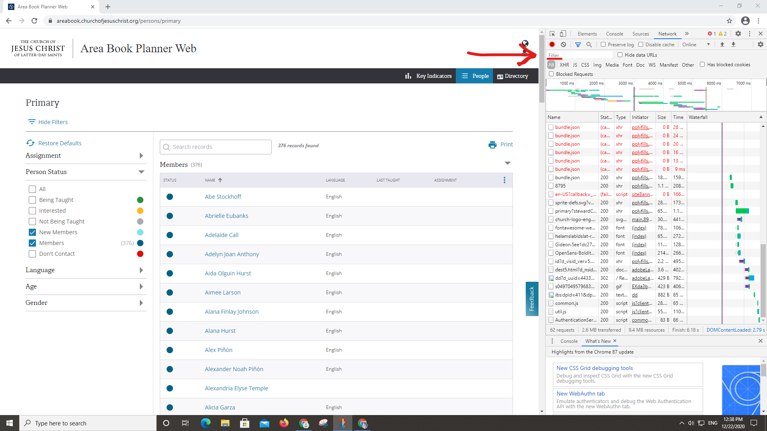
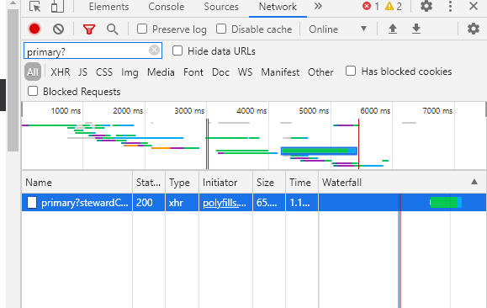
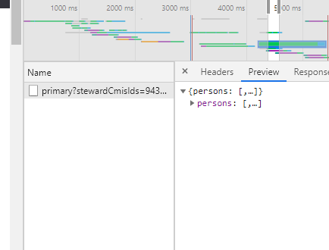
Step 2: scavenger hunt
5. 6.
Once the page loads completely, click in the “Filter” bar in the networking window. Search “primary?” (If no files show up, reload the webpage) If there's more than one, find the file with a preview of “persons" when you click on it →
LOOK FOR THIS

Slide 8
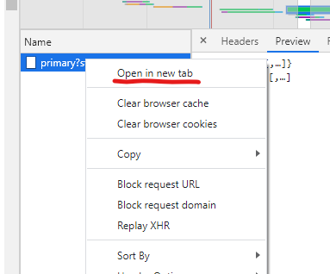
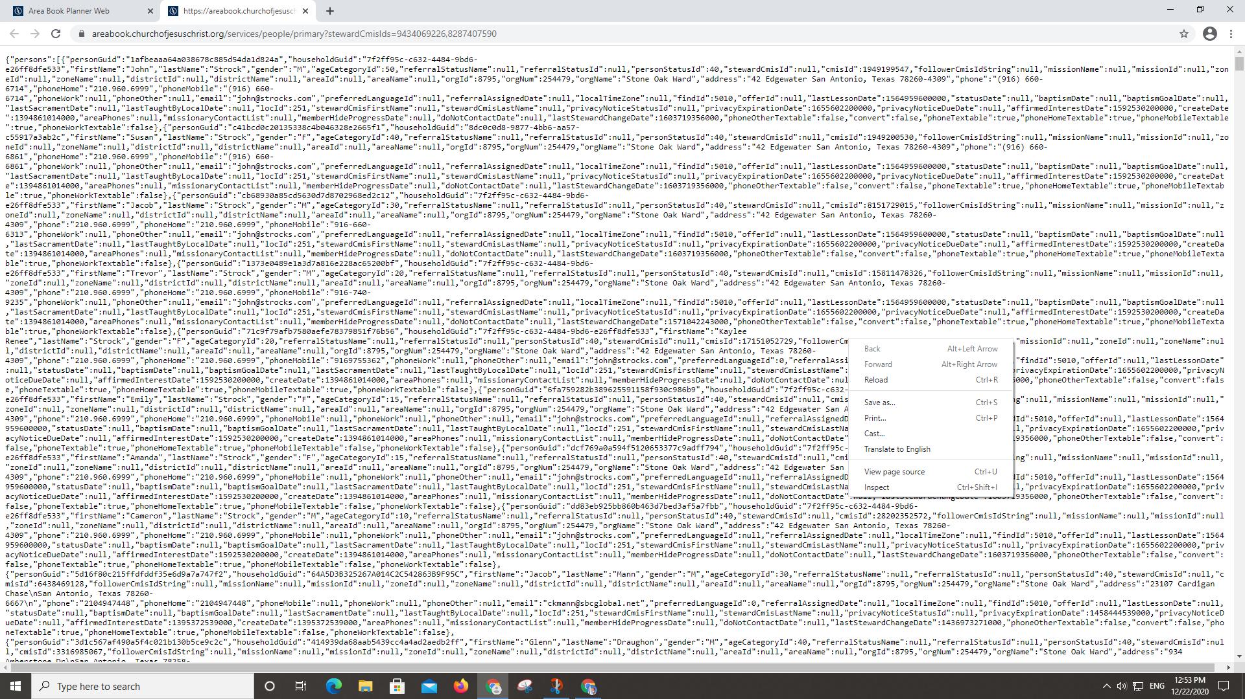
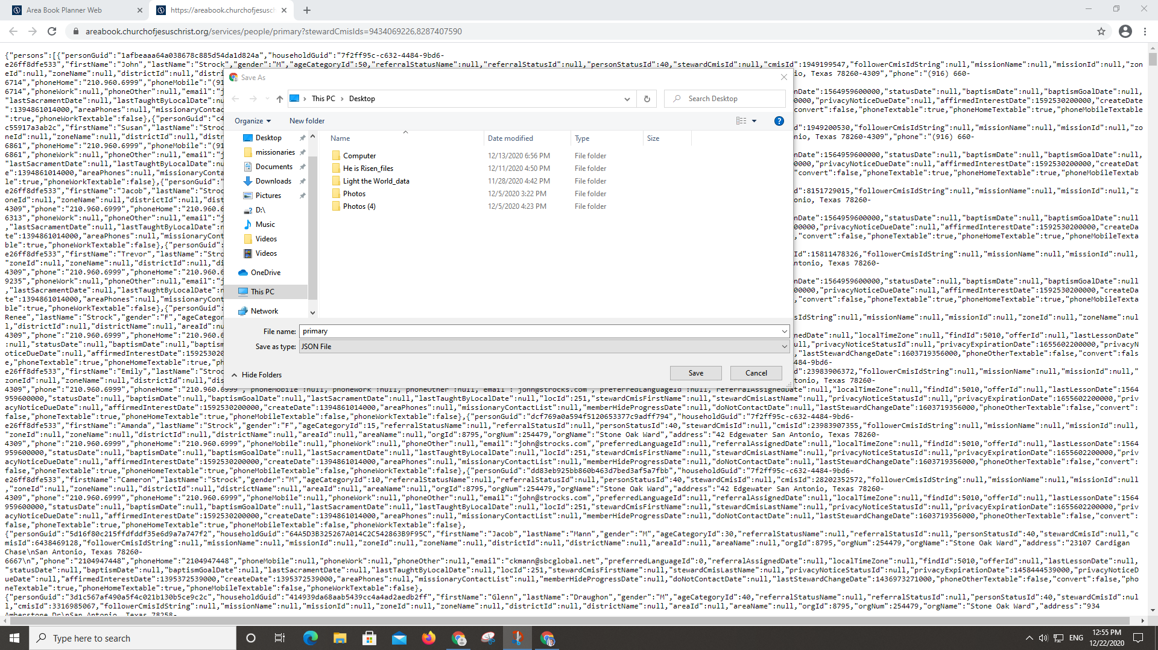
Step 3: keep things local
7. 8.
Right click and choose “open in new tab”. It should be a tab filled with code Right-click the text and select “save as". Save the file.

Slide 9
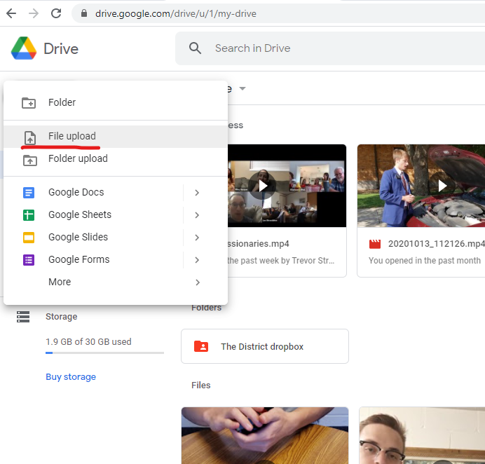
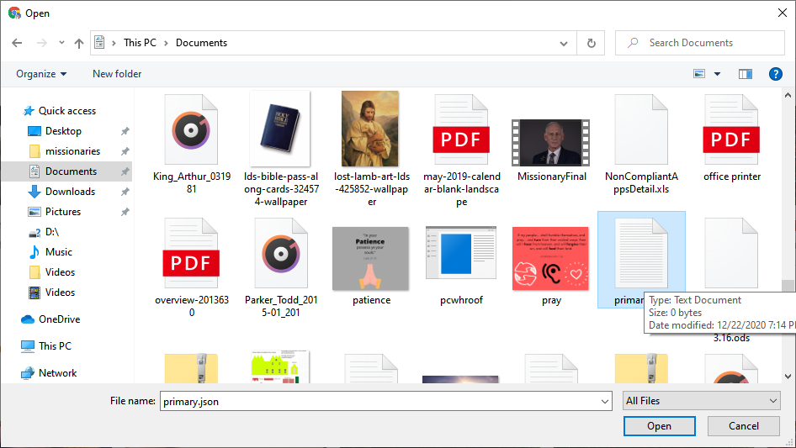
Step 4: put it in drive
9. 10.
Open google drive* and select “new” → “file upload” Select the file you just made. It doesn’t matter where in your google drive it ends up.
*area emails do not work; use your personal missionary email and then share it with your area email afterwards.

Slide 10
Now we have the file!
Next we’ll set up the spreadsheet.

Slide 11
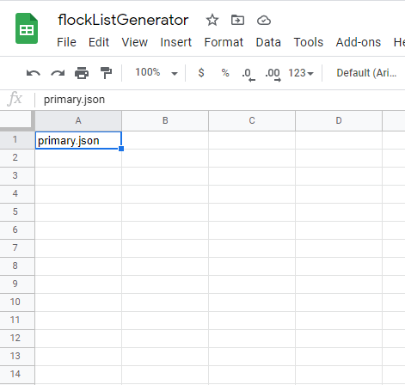
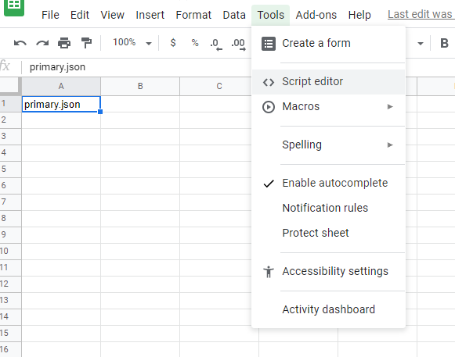
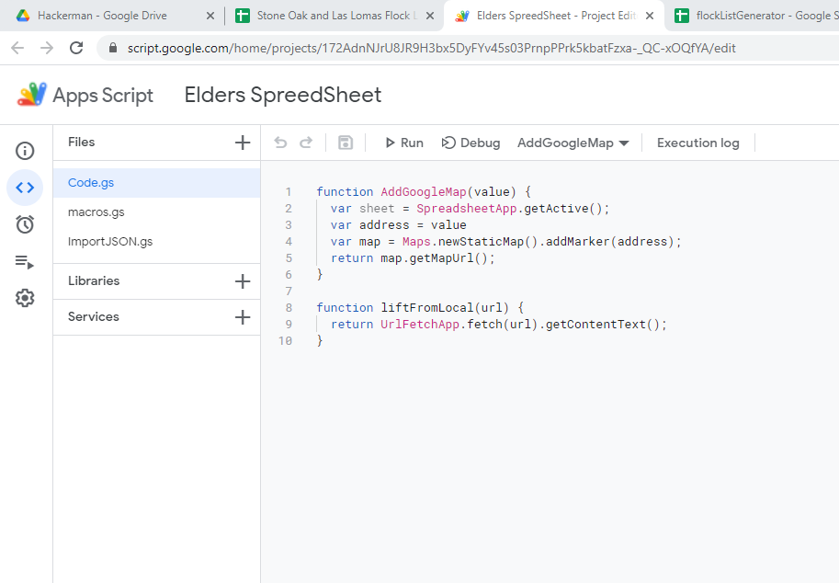
Step 5: set the stage
11. 12. 13.
Go to the spreadsheet that will be your flocklist. In the top left cell (A1), put the name of your file. Match cases and add the file type if it’s there, e.g. primary.json not primary or Primary.json Click “Tools” → “<> Script Editor”. This will open up another tab like this → (Delete all the code right now. It will get in your way)

Slide 12
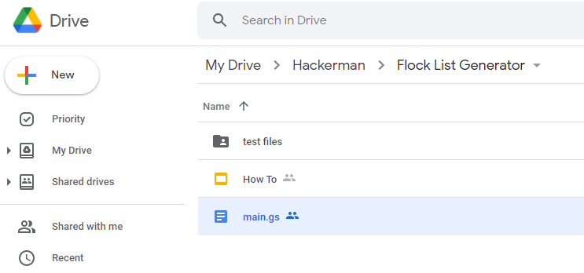
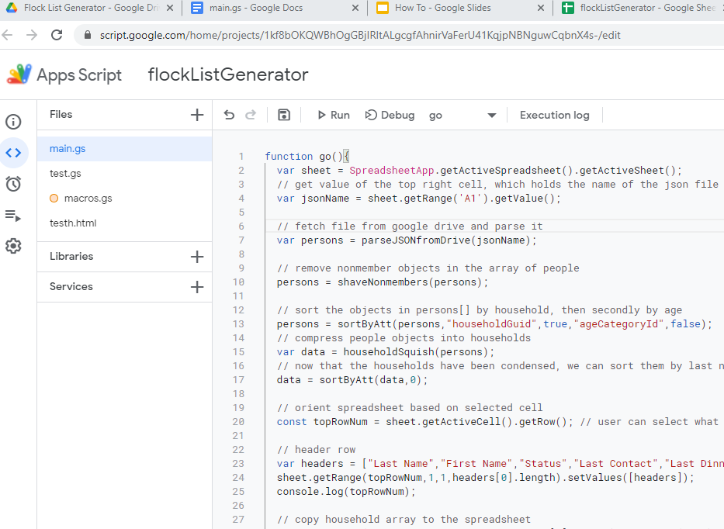
Step 6: hackerman
14. 15. 16. 17.
In the drive folder Flock List Generator, find the document called main.gs and copy the contents Paste the code into the script editor window (did you delete the code that was already in the console?) Save, then hit “Run”. Give the script requested permissions. A message bar will appear at the bottom of the code. If there's a red error, something went wrong. But if it’s yellow & it says “execution complete", congratulations- it worked!
1
2

Slide 13

Tech problems?
If there’s a red error message or if any of these steps don’t make sense, reach out to me with a screenshot & a description of what’s going on:
andrewkjones3.14@gmail.com
I’ll do my best to help you find a solution! (Be sure to mention the flockListGenerator)

